Slide 1

Extra Exercises On Relational Mapping
CSC380

Slide 2
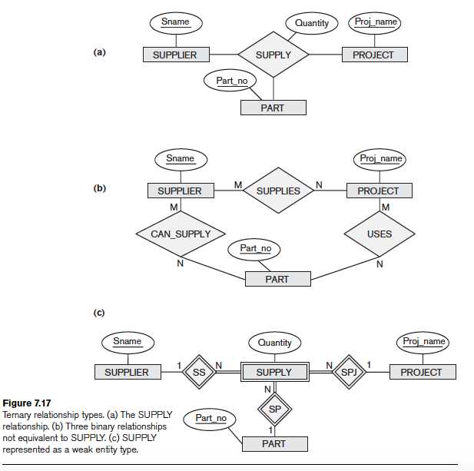
1. Map the following ERs to Relational Schema

Slide 3
Let’s Map (b) the three binary relationship
(b)
SUPPLIER(Sname);
PROJECT(Proj_name);
PART(Part_no);
SUPPLIES(Sname, Proj_name);
CAN_SUPPLY_PARTS(Sname, Part_no);
USES_PARTS(Proj_name, Part_no);

Slide 4
Let’s Map (a) the ternary relationship
(a)
SUPPLIER(Sname);
PROJECT(Proj_name);
PART(Part_no);
SUPPLY(Sname, Part_no, Proj_name, Quantity);

Slide 5
Let’s Map (c) the ternary relationship as a week entity
(c)
SUPPLIER(Sname);
PROJECT(Proj_name);
PART(Part_no);
SUPPLY(Sname, Part_no, Proj_name, Quantity);

Slide 6
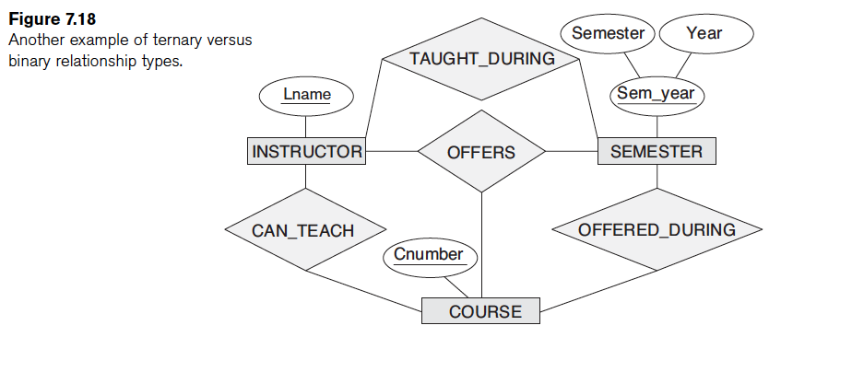
2. Map the following ERs to Relational Schema

Slide 7
2.
INSTRUCTOR(Lname);
SEMESTER(Semester, Year);
COURSE(Cnumber);
INS_TAUGHT_DURING_SEM(Lname, Semester, Year);
INS_CAN_TEACH_COURSE(Lname, Cnumber);
COURS_OFFERED_DURING_SEM(Cnumber, Semester, Year);
OFFERS(Lname, Semester, Year, Cnumber);

Slide 8
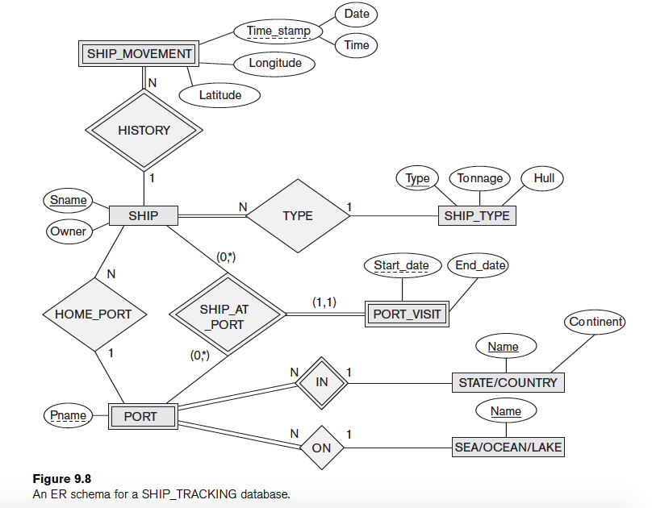
3. Figure 9.8 shows an ER schema for a database that can be used to keep track of transport ships and their locations for maritime authorities. Map this schema into a relational schema and specify all primary keys and foreign keys.
Notes:
SHIP(SNAME, OWNER, TYPE, PNAME);
SHIP_TYPE(TYPE, TONNAGE, HULL);
STATE_COUNTRY(NAME, CONTINENT);
SEAOCEANLAKE(NAME);
SHIP_MOVEMENT(SSNAME, DATE, TIME, LONGITUDE, LATITUTE);
PORT(S_C_NAME, PNAME, S_O_L_NAME);
VISIT(VSNAME, VPNAME, STARTDATE, ENDDATE);

Slide 9
3. Figure 9.8 shows an ER schema for a database that can be used to keep track of transport ships and their locations for maritime authorities. Map this schema into a relational schema and specify all primary keys and foreign keys.
SHIP(SNAME, OWNER, TYPE, PNAME);
SHIP_TYPE(TYPE, TONNAGE, HULL);
STATE_COUNTRY(NAME, CONTINENT);
SEAOCEANLAKE(NAME);
SHIP_MOVEMENT(SSNAME, DATE, TIME, LONGITUDE, LATITUTE);
PORT(S_C_NAME, PNAME, S_O_L_NAME);
VISIT(VSNAME, VPNAME, STARTDATE, ENDDATE);

Slide 10
Questions?

